Slide 1
PROJECT TITLE
CAPSTONE PROJECT
Presented By:
Mohan Elango K
Jayaraj Annapackiam CSI College Of Engineering
Mechanical Engineering

Slide 2
OUTLINE
Problem Statement
Proposed System/Solution
System Development Approach
Algorithm & Deployment
Result
Conclusion
Future Scope
References

Slide 3
Problem Statement
The problem statement is that if any user wants to buy a laptop then our application should be compatible to provide a tentative price of laptop according to the user configurations.
Although it looks like a simple project or just developing a model, the dataset we have is noisy and needs lots of feature engineering, and preprocessing that will drive your interest in developing this project.
The challenge in the laptop market lies in the complexity of pricing, where consumers face difficulty in understanding the correlation between specifications and pricing. Retailers and manufacturers also struggle to set competitive prices amidst dynamic market conditions.

Slide 4
Proposed Solution
The proposed system aims to revolutionize the laptop pricing domain by introducing a data-driven, automated approach that not only addresses the deficiencies of the existing system but also provides a more accurate and efficient solution for determining laptop prices.
Automated Price Determination: By substituting an automated mechanism for human evaluation, laptop pricing can be made consistent and effective.
Predictive Modelling: Based on a variety of laptop features, the Random Forest algorithm is used to
accurately estimate prices.
Web Application: Using Stream lit, create an intuitive web application that lets consumers enter laptop specs and get price estimates in real time.

Slide 5
System Approach
SYSTEM APPROACH Building the proposed solution would involve a combination of data processing, feature engineering, and machine learning. Here are the key system and library requirements: System Requirements: 1. Hardware: -A computer with sufficient processing power, preferably with multiple cores or a GPU for faster training of machine learning models. -Adequate RAM to handle the size of the dataset and computational requirements. 2. Software: -An operating system compatible with the required machine learning libraries (eg, Windows, Limax, macOS)

Slide 6
Algorithm & Deployment
Dataset selection:The first step of the machine learningalgorithm is to select a dataset.for training. The dataset selection depends on the type of problem hand and the availability of data.
Data pre-processing :Data pre processing is the process of collecting and cleaning data to reduce noise and increase its accuracy. This can be done by using algorithms that remove unknown values, outliers, or other factors that could affect the outcome of a prediction
Feature selection: Feature selection is the process of identifying the most important features. This can be done using an exploratory process, or by using a pre-processing step such as principal component analysis. The goal is to choose features that are relevant for predicting the outcome variable in our model.

Slide 7
Algorithm and deployment
Prediction Model: Once you have converted your data into a format that can be processed by machine learning algorithms, we will build an accurate prediction model for you. We have several models available for different purposes like predicting high-end laptops, budget laptops orall rounder's etc. You can choose from our models based on your need and budget constraints.
Deployment:
The given project is still under the development. We are working to add new features in this WebApp.
Currently we have added features such as Prediction, Comparison and News Update related to Laptops which makes easier for the Consumer to take the decision.

Slide 8
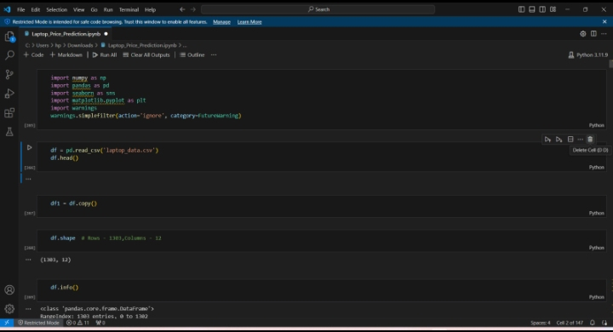
Result

Slide 9
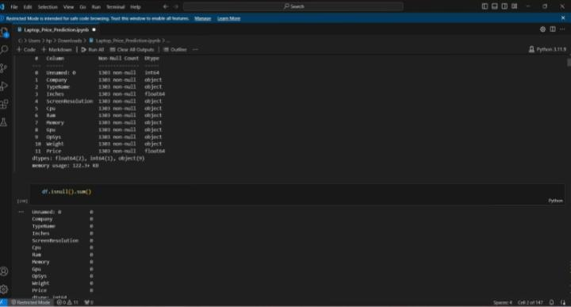
Result

Slide 10
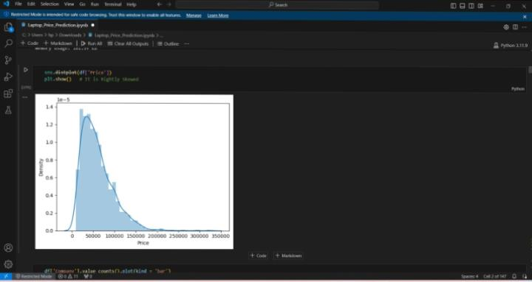
Result

Slide 11
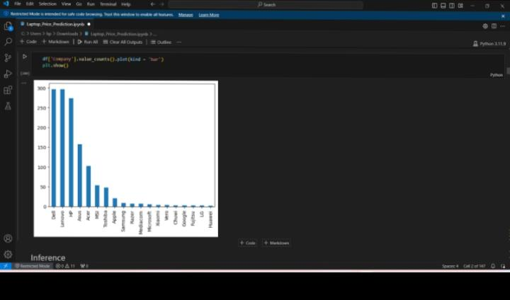
REsULT

Slide 12
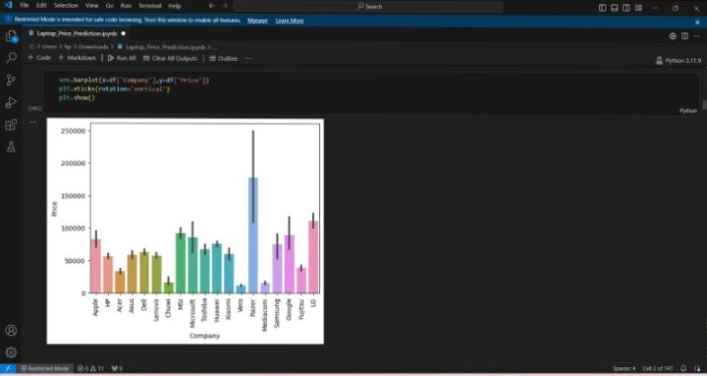
Result

Slide 13
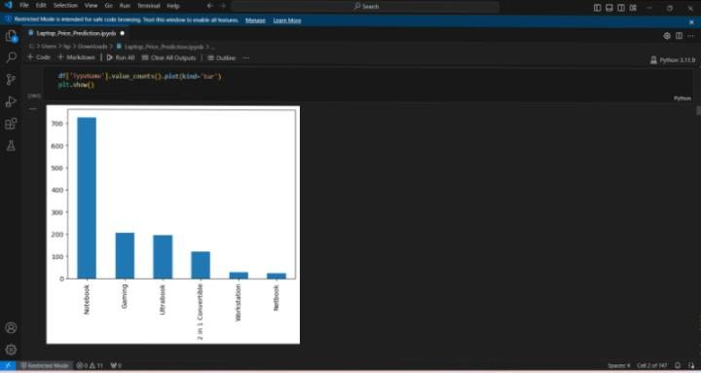
Result

Slide 14
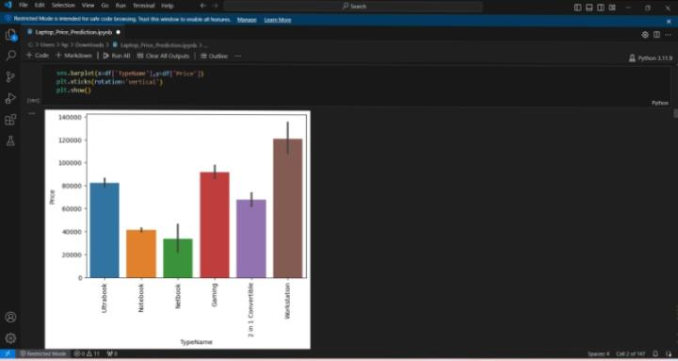
Result

Slide 15
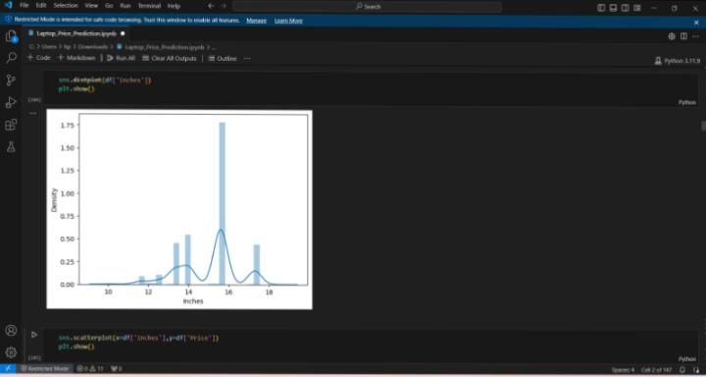
Result

Slide 16
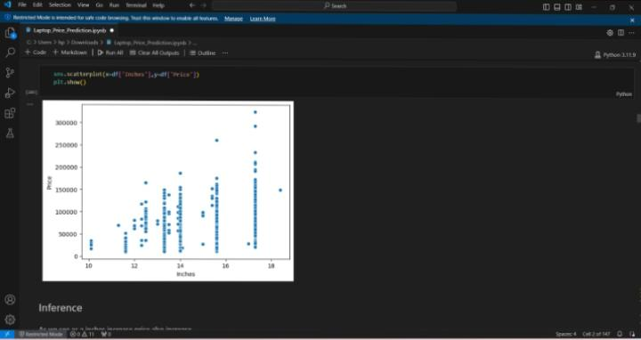
Result

Slide 17
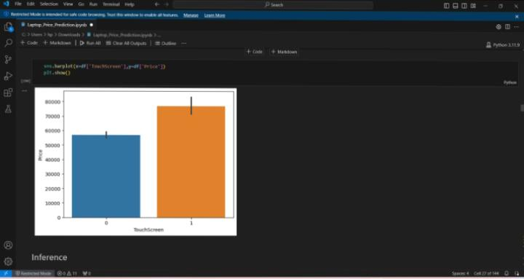
Result

Slide 18
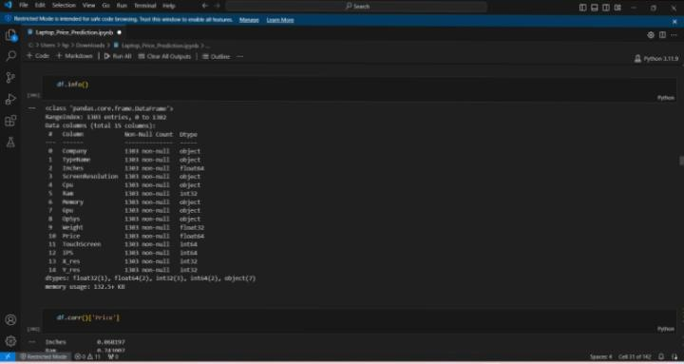
Result

Slide 19
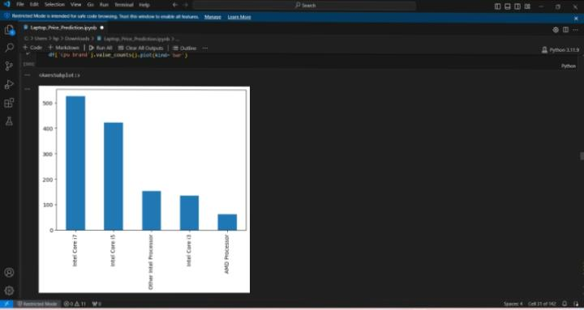
Result

Slide 20
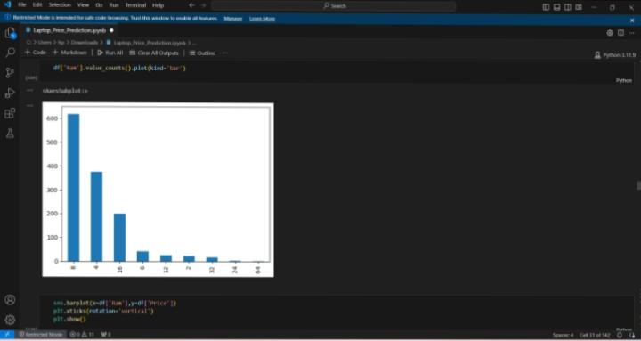
Result

Slide 21
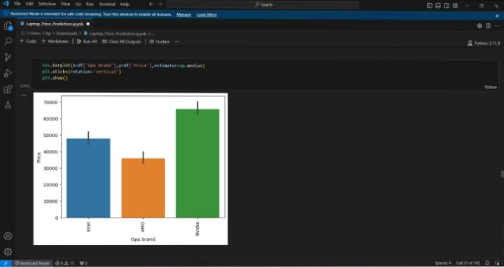
Result

Slide 22
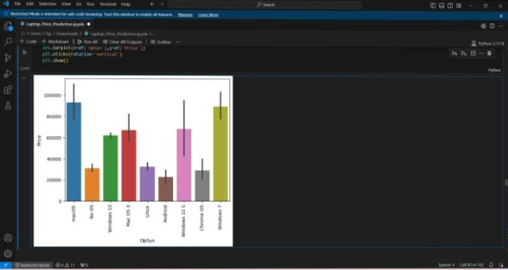
Result

Slide 23
Conclusion
Predicting something through the application of machine learning using the Decision Tree algorithm makes it easy for students, especially in determining the choice of laptop specifications that are most desirable for students to meet student needs and in accordance with the purchasing power of students.
Students no longer need to look for various sources to find laptop specifications that are needed by students in meeting the needs of students, because the laptop specifications from the results of the machine learning application have provided the most desirable specifications with their prices of laptops.
Dynamic Pricing Models: Develop dynamic pricing models that adapt to real-time market trends, demand-supply dynamics, and competitor pricing strategies. Incorporate time-series analysis and reinforcement learning to optimize pricing strategies over time.

Slide 24
Future scope
Dynamic Pricing Models: Develop dynamic pricing models that adapt to real-time market trends, user demand, competitor pricing strategies, and other external factors. Incorporate time-series analysis and reinforcement learning techniques to optimize pricing strategies dynamically.
Cross-domain Applications: Extend the predictive model to other related domains such as tablets, smartphones, or consumer electronics, leveraging the knowledge and methodologies developed in the laptop price prediction project to provide valuable insights across a broader range of products.
Integration with E-commerce Platforms: Collaborate with e-commerce platforms to integrate the price prediction system directly into their websites or applications, providing users with real-time pricing insights and recommendations while browsing for laptops.

Slide 25
References
https://medium.com/analytics-vidhya/predicting-laptop-prices-using-ml-
e60a0315b45
https://www.kaggle.com/code/danielbethell/laptop-prices-prediction
https://issuu.com/pricedetailsindia/docs/blog_compare_laptop_price_and_its_f

Slide 26
THANK YOU

